Slide 1

Fundamentals of Human-Centered Design
Day 2
Patty Beirne Patricia.Beirne@opm.gov
Corinne Vizzacchero Corinne.Vizzacchero@opm.gov

Slide 2
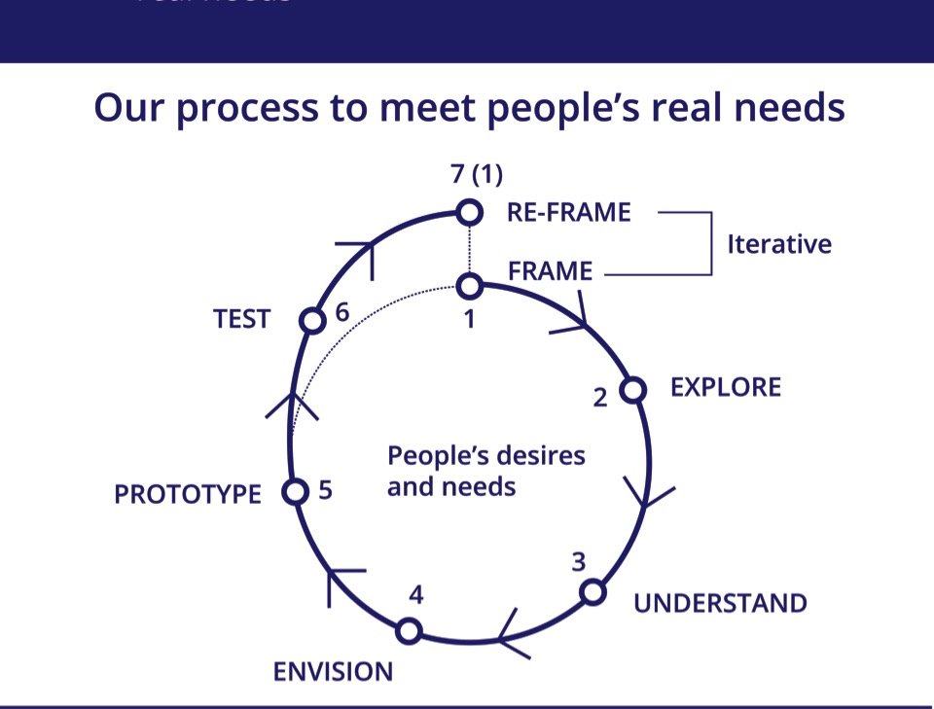

Slide 3


Understand:
Packaging and handling data

Slide 4
Packaging and handling data
Understand
On yellow post-its write out your data points— one per post-it (quotes and/or observations)
Review photos, select observations, and write a keyword or brief description of the selections
Notes:
Current state

Slide 5
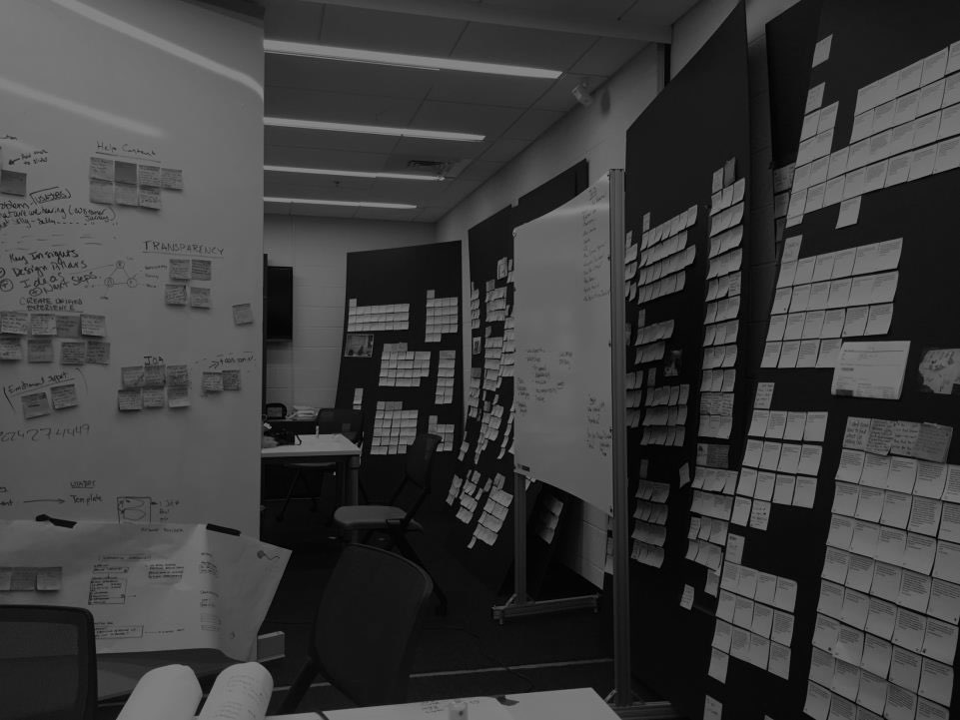
“I don’t know what keywords to use since there are so many.”
“Applying for Federal jobs is going to be a long drawn out process and you will have your heart broken at the end of it.”
"Usually when I hear I didn't make the list for consideration I don't care anymore. I tried that, you can't get in touch with anyone for an explanation. When you get through to someone they don't have answers for you”
“In USAJOBS a lot of language is extremely confusing, the structure of job announcements is not user friendly, interaction with our agency is clunky and we lose applicants along the way.”
“If you have questions about USAJOBS you have to figure it out on your own. I check with social media to get an understanding of the website.”

Slide 6
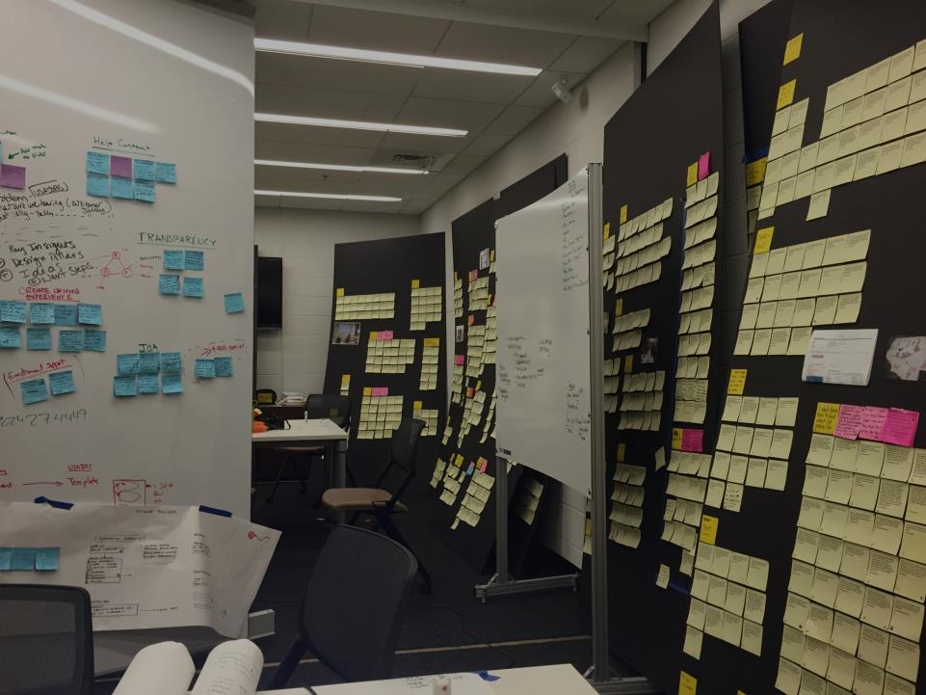

Slide 7
Understand:
Data synthesis

Slide 8
Data synthesis
In order to bring clarity to complex data sets and identify useful patterns, we must be organized and adaptable.
Understand

Slide 9
Data synthesis
The process of uncovering the meaning behind the data collected related to people’s real needs.
Understand

Slide 10
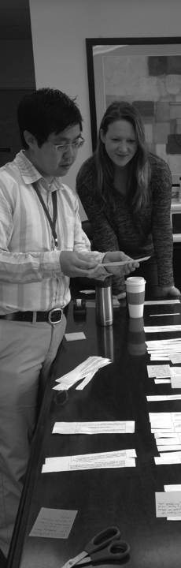
Data synthesis
How insights connect with research
Understand
Pieces of qualitative data (Data Points)
Field notes
“
”
+
“
”

Slide 11
Data synthesis
Pattern finding
Understand
“
”
One person places and describes a single data point.

Slide 12
Data synthesis
Pattern finding
Understand
“
“
”
”
Invite others to place items together to create meaningful groups from inferences.

Slide 13
Data synthesis
Pattern finding
Understand
Meaning is generated by asking questions like:
What is this saying about a particular context?
What caused or prompted the person to think/say this?
If I read between the lines, does it speak to something larger?
What about this situation would lead a person to say this or do this? (Go back and remember the context for this moment)
“
“
”
”
Invite others to place items together to create meaningful groups f from inferences.
Notes:
Meaning is generated by asking questions like:
What is this saying about a particular context?
What caused or prompted the person to think/say this?
If I read between the lines, does it speak to something larger?
What about this situation would lead a person to say this or do this? (Go back and remember the context for this moment)

Slide 14
Data synthesis
Pattern finding
Understand
“
“
”
”
“
“
”
”
Invite others to place items together to create meaningful groups from inferences.

Slide 15
Data synthesis
Pattern finding
Understand
“
“
”
”
“
“
“
”
”
”
“
“
”
”
Invite others to place items together to create meaningful groups from inferences.

Slide 16
Data synthesis
Pattern finding
Understand
“
”
“
“
“
”
”
”
“
“
“
“
”
”
”
”
“
“
“
”
”
”
Invite others to place items together to create meaningful groups from inferences.

Slide 17
Data synthesis
Pattern finding
Understand
“
”
“
“
“
”
”
”
“
“
“
“
”
”
”
”
Label the clusters as they take shape. Create a phrase for the cluster. Think: “This relationship has something to do with _____.”
“
“
“
”
”
”

Slide 18
Data synthesis
Pattern finding
Understand
“
”
“
“
“
”
”
”
“
“
“
“
“
”
”
”
”
”
Discuss, rearrange, and re-label items as groupings emerge.
“
“
”
”

Slide 19
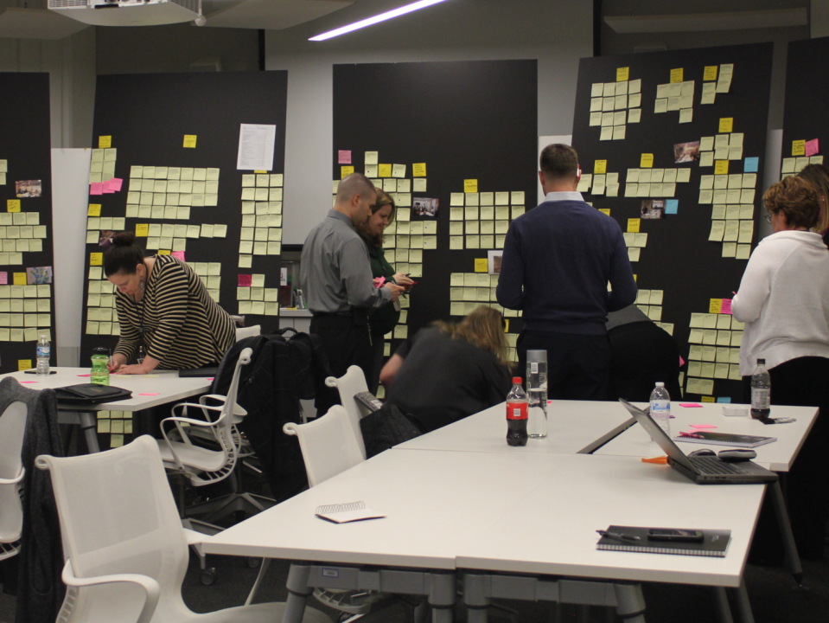

Slide 20
Data synthesis
Insight generation
What is an insight? A single phrase that exhibits a deeper understanding of a person, a thing, or situation, framed as a definitive statement of truth.
Understand

Slide 21
Data synthesis
Insight generation
What is NOT an insight? 1. Data (Insight needs action) 2. Observation (Observations do not have the motivation behind the behavior) 3. Customer wish or statement of need
Understand

Slide 23
Articulating Opportunities
Why Not Start with a Question?
Just three little words:
How might we…?
Notes:
A common way to intentionally orient and articulate design challenges is as a “how might we” question.
You don’t have to use this construction, but these 3 words and a question mark have specific benefits:
[Continued on following slides]

Slide 24
Articulating Opportunities
Why Not Start with a Question?
Just three little words:
How might we…?
Action/goal oriented
Notes:
[See slide. Explain benefits of each word—continued on following slides.]

Slide 25
Articulating Opportunities
Why Not Start with a Question?
Just three little words:
How might we…?
Action/goal oriented
Open-ended potential
Notes:
[See slide. Explain benefits of each word—continued on following slide.]

Slide 26
Articulating Opportunities
Why Not Start with a Question?
Just three little words:
How might we…?
Action/goal oriented
Open-ended potential
Collaborative & inviting

Slide 27
Envision:
Idea generation

Slide 29
What is ideation?
Ideation is the creative process of generating, developing, and communicating new ideas within a design framework.
Envision

Slide 30
Idea generation
Envisioning new futures requires building on other people’s ideas and "green housing" ideas that may feel unfinished or incomplete at the time.
Envision

Slide 31
Tips for design collaboration
Envision
Yes, and…
Defer judgment
There is no right answer
Diversity is good
Work visually when possible
Everything is temporary
Have fun!
Notes:
The goal is quantity not quality (Quality comes later) / “write first, edit later” (they’re not the same)
No judging/trust : no idea is stupid, obvious, absurd, silly, impossible // but also: not trying to reach consensus (Consensus comes later) yes, and… Generate/Additive (Reductive comes later)
Magic wand it! How might we … without constraints? Money? Permission/approval? Tech?
Write, but maybe also draw. Just don’t let ideas disappear into the ether

Slide 32
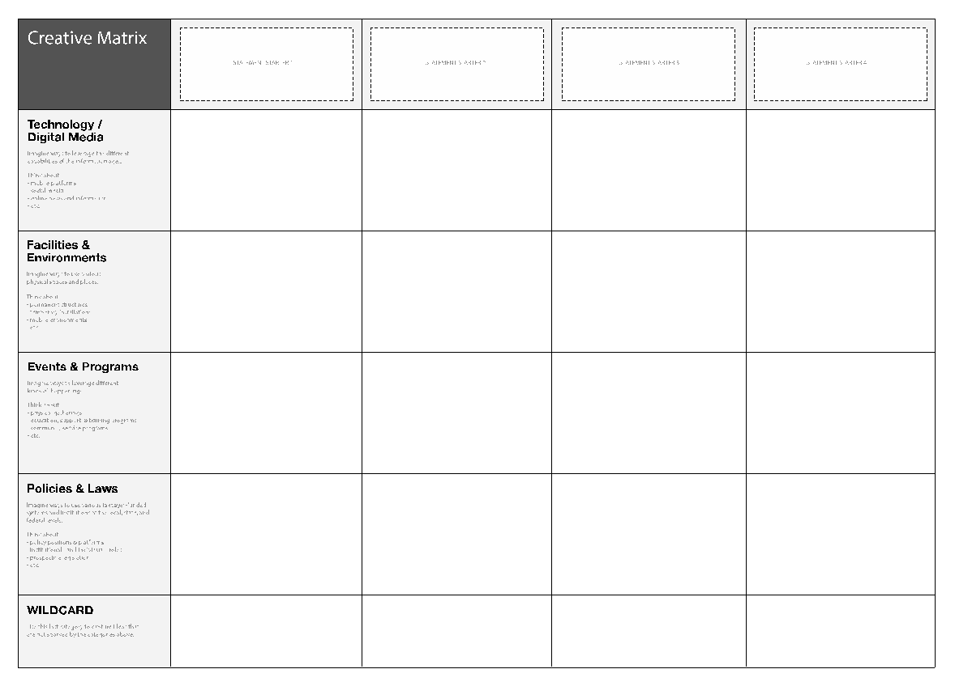
Creative matrix
Envision
enablers
And
mechanisms
How Might We?
New Ideas

Slide 33
Envision:
Prioritization of ideas

Slide 34
Importance/difficulty matrix
Visioning
More Difficult
Less Important
More Important
Less Difficult

Slide 35
Importance/difficulty matrix
Visioning
As a team discuss what your specific definitions for importance and difficulty are.
First, take your ideas and force rank them across the matrix from least to most important. This will require discussion and collaboration.
Once in place on the horizontal axis do not move your Post-Its horizontally. While keeping them in order, move them up or down depending on their difficulty in relation to one another.

Slide 36
Importance/difficulty matrix
Visioning
More Difficult
LUXURY
STRATEGIC
Less Important
More Important
LOW HANGING FRUIT
HIGH R.O.I.
Less Difficult

Slide 37
Prototype:
Learning by making

Slide 39
I learned... I relearned... I wonder... I was surprised... I hope... I plan to...

Slide 40
Prototype:
Learn by making
Day 3

Slide 41
A prototype is…
A first simple model, draft, or version of a design or an idea that tests a concept or process in the real world.
Prototype
Notes:
prototyping is a series of small experiments that helps us t o better
understand what we’re trying to build, the context or environments within
which our product, service, or process will live, and the underlying/hidden assumptions
can take many forms; it might be a sketch, a model made of cardboard, or a role-playing simulation of a service,
Make tangible: Allows you to observe someone interact with, or ask for direct feedback about

Slide 42
The value of a prototype
Prototype
It tests the design in the real world.
It manages risk.
It increases collaboration and co-creation.
It demonstrates theoretical concepts.
It makes the concept available to all.
Notes:
The goal is learning, and not to prove that your idea is a “success.” If your best guess at
a solution turns out to be a total dud, that is valuable information to gather
now because it means you failed small, and can address the problem (or
move on to another concept altogether) before implementing your new
system, service, or product at a larger scale.

Slide 43
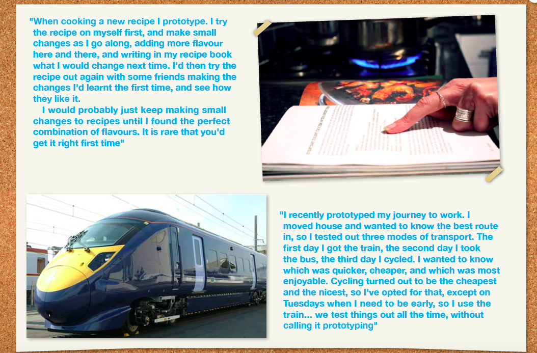

Slide 44
Notes:
update

Slide 45

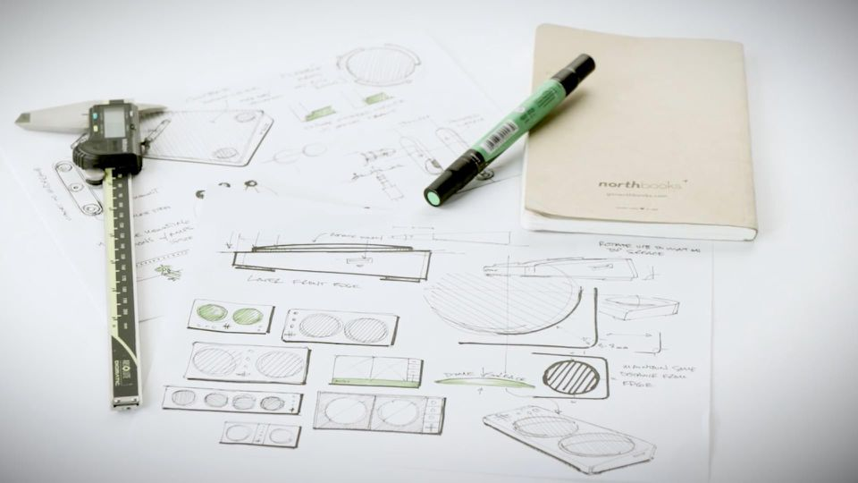
The value of a prototype
Prototype
Notes:
The genesis of the Xbox Adaptive Controller goes back to 2014, when a Microsoft engineer was scrolling through Twitter and noticed a photo of a custom gaming controller made by Ken Jones (mechanical engineer, founder) of Warfighter Engaged a nonprofit that modifies gaming devices for injured and disabled Veterans.

Slide 46
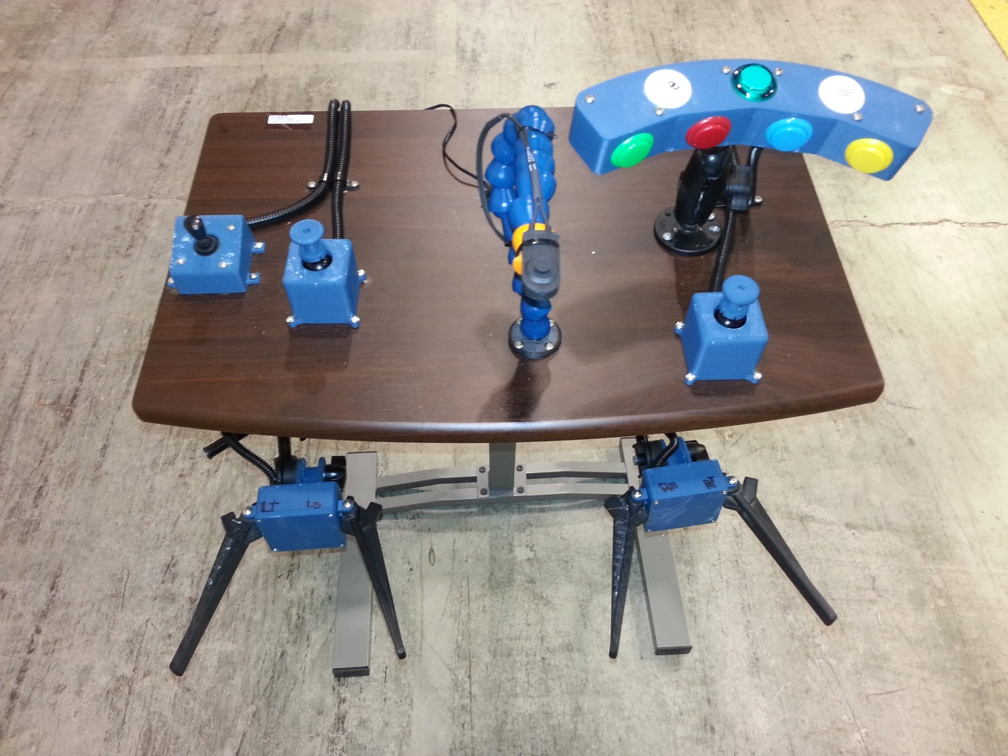
The value of a prototype
Prototype
Notes:
Example warfighter engaged project / wireless XBOX One console /
quadruple amputee Marine
All of the custom assemblies were made in a 3d printer
Adjustable table was used as a mounting stand (up, down, left, right), adjustable arms
paddles for each thigh
A bite switch was added as a redundant left trigger button.
every controller function, relocated

Slide 47
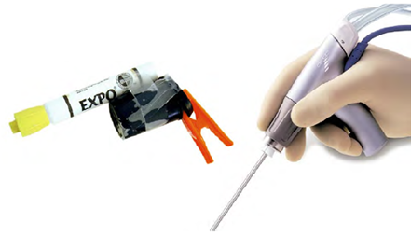
The value of a prototype
Prototype

Slide 48
The value of a prototype
Prototype
Notes:
Low fidelity prototyping activity

Slide 49
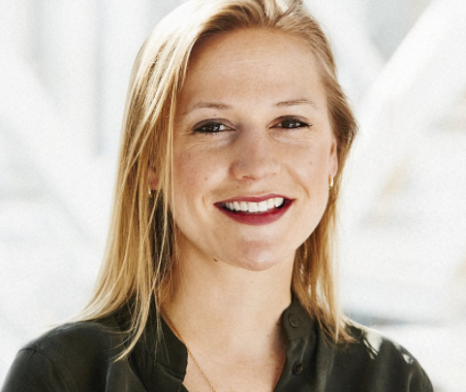
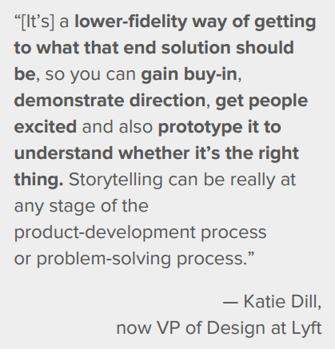
Storytelling as prototyping
Prototype

Slide 50
Storytelling principles
Prototype
Think more information is better | Emotion over information
Go through it step by step | Only show what’s critical
Explain each part in detail | Create viral experiences
Make it flashy to grab attention | Engage with the right level of fidelity
Notes:
Patty!

Slide 51
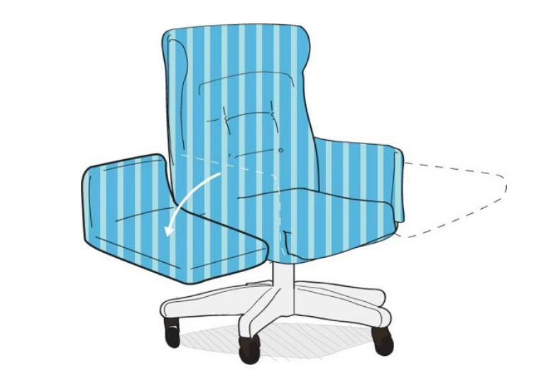

Storytelling principles
Prototype

Slide 52
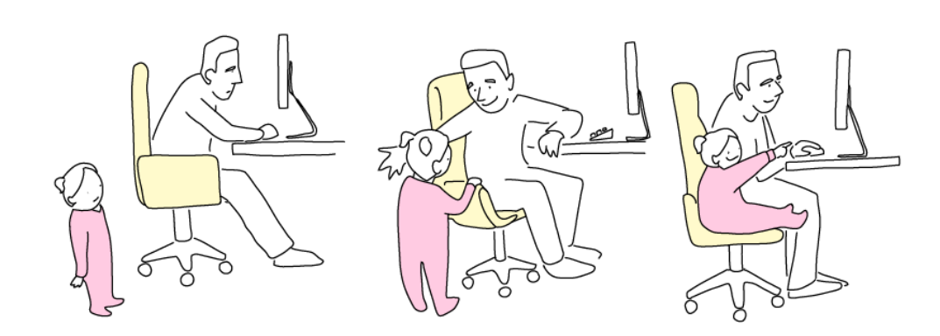
Storytelling principles
Prototype

Slide 53
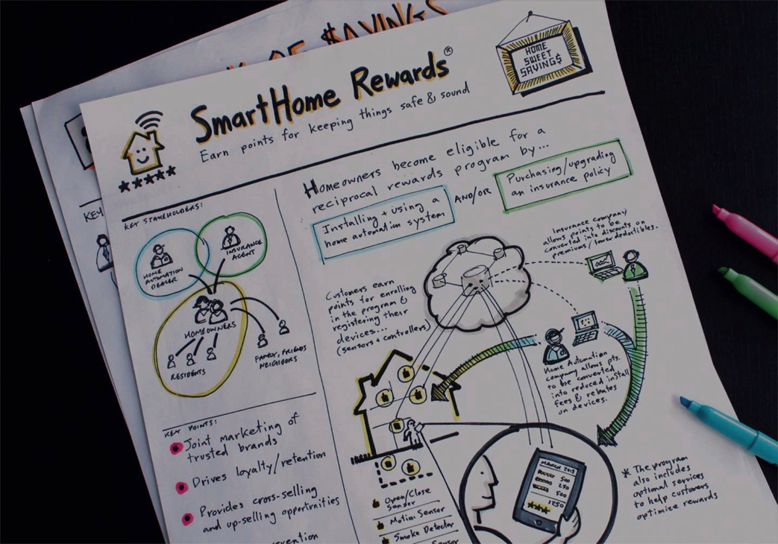
Concept poster
Envision
Notes:
Move to end?

Slide 54
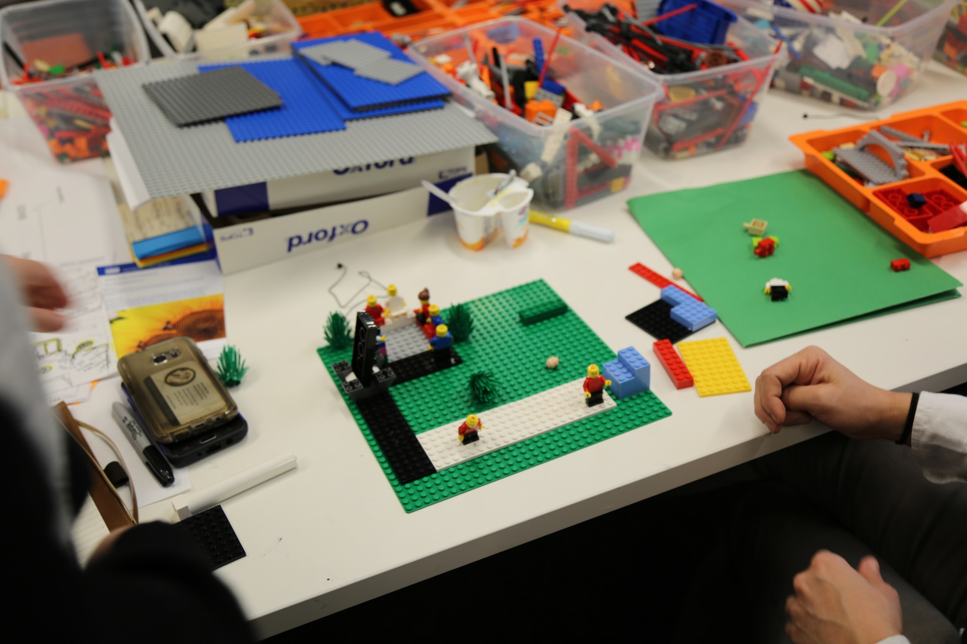
Practicing prototyping
Prototype

Slide 55
Constructive critique
con·struc·tive adjective
Prototype
of or relating to construction or creation
promoting improvement or development
Notes:
Critique =!= user feedback
Yes, and (etc)

Slide 57
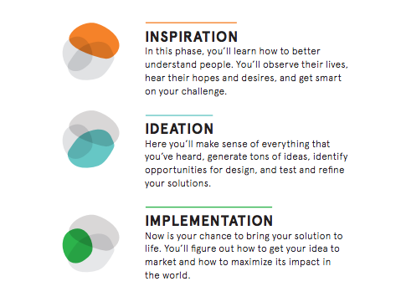
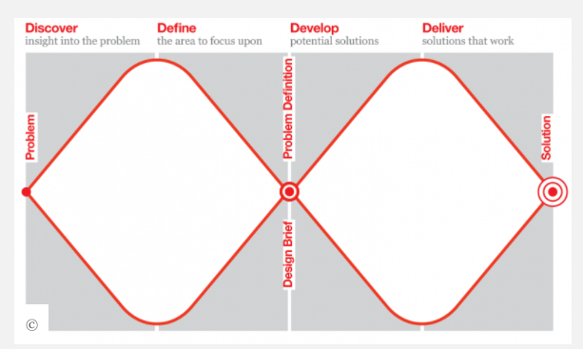
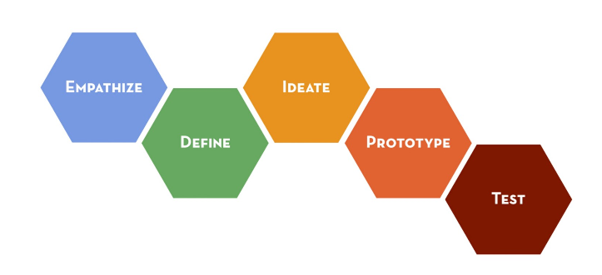
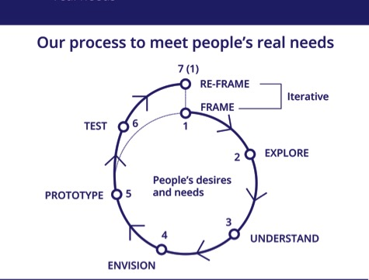
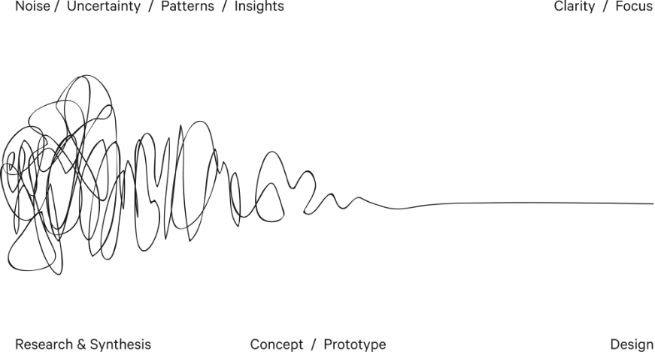
Notes:
https://designfuckingthinking.tumblr.com/

Slide 58
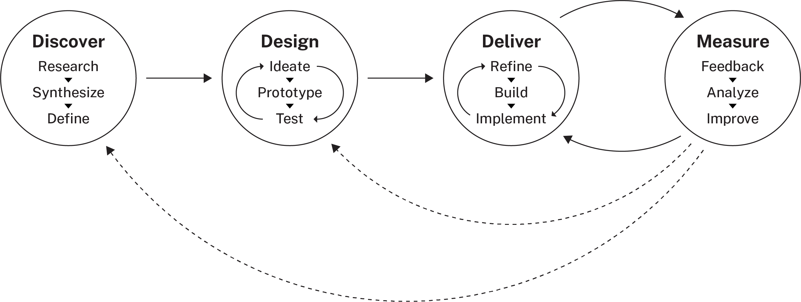
Design + Innovation
Notes:
Essentially:
Starts with research re: user needs
Not linear Diverge + converge Generative, constructive Iterative

Slide 59
I learned... I relearned... I wonder... I was surprised... I hope... I plan to...

Slide 60

Thank You!
Patty Beirne Patricia.Beirne@opm.gov
Corinne Vizzacchero Corinne.Vizzacchero@opm.gov

